Slide 1

lesson 9
  Types of
  Storage Devices

Slide 2
This lesson includes the following sections:
    Categorizing Storage Devices
    Magnetic Storage Devices
    Optical Storage Devices

Slide 3
Categorizing Storage Devices
Storage devices hold data, even when the computer is turned off.
The physical material that actually holds data is called a storage medium. The surface of a floppy disk is a storage medium.
The hardware that writes data to or reads data from a storage medium is called a storage device. A floppy disk drive is a storage device.
The two primary storage technologies are magnetic and optical.

Slide 4
The primary types of magnetic storage are:
Diskettes (floppy disks)
Hard disks
High-capacity floppy disks
Disk cartridges
Magnetic tape

Slide 5
The primary types of optical storage are:
Compact Disk Read-Only Memory (CD-ROM)
Digital Video Disk Read-Only Memory
(DVD-ROM)
CD-Recordable (CD-R)
CD-Rewritable (CD-RW)
PhotoCD

Slide 6
Magnetic Storage Devices
How Magnetic Storage Works
Formatting
Disk Areas
Diskettes
Hard Disks
Disk Capacities
Other Magnetic Storage Devices

Slide 7
Magnetic Storage Devices
- How Magnetic Storage Works
A magnetic disk's medium contains iron particles, which can be polarized—given a magnetic charge—in one of two directions.
Each particle's direction represents a 1 (on) or 0 (off), representing each bit of data that the CPU can recognize.
A disk drive uses read/write heads containing electromagnets to create magnetic charges on the medium.

Slide 8
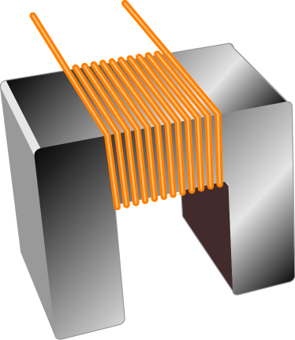
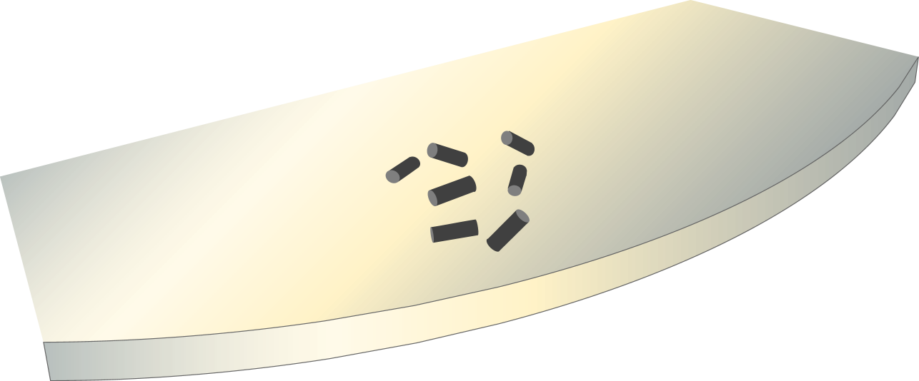
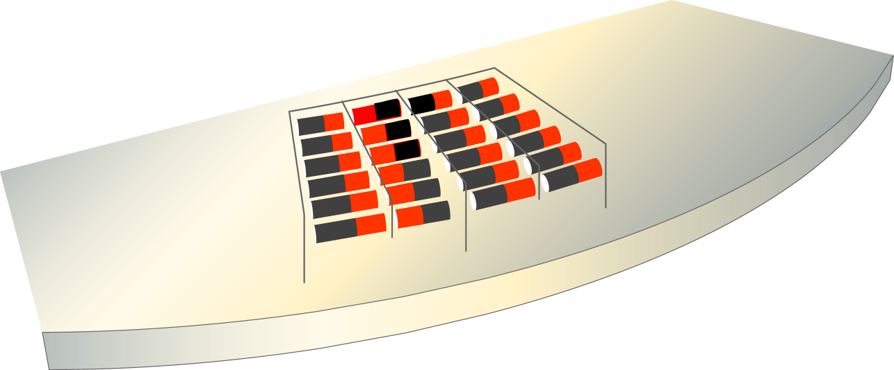
Write head
Medium
Random particles
(no data stored)
Current flow
(write operation)
Organized particles
(represent data)

Slide 9
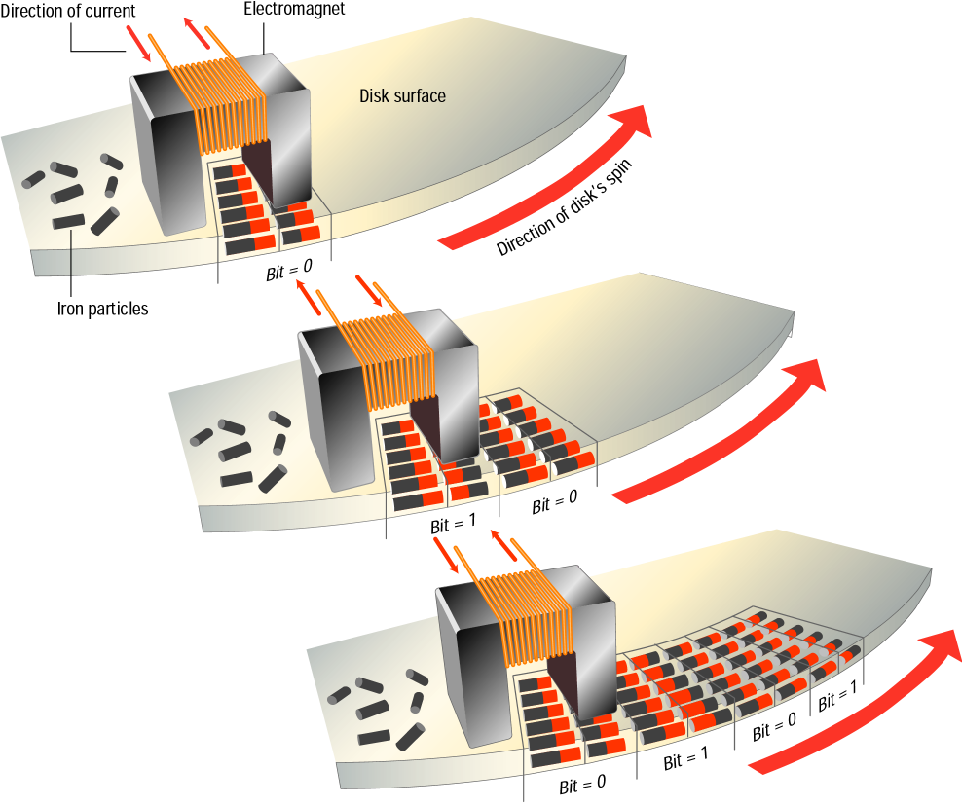
As the medium
rotates, the head
writes the data.

Slide 10
Magnetic Storage Devices - Formatting
Before a magnetic disk can be used, it must be formatted—a process that maps the disk's surface and determines how data will be stored.
During formatting, the drive creates circular tracks around the disk's surface, then divides each track into sectors.
The OS organizes sectors into groups, called clusters, then tracks each file's location according to the clusters it occupies.

Slide 11
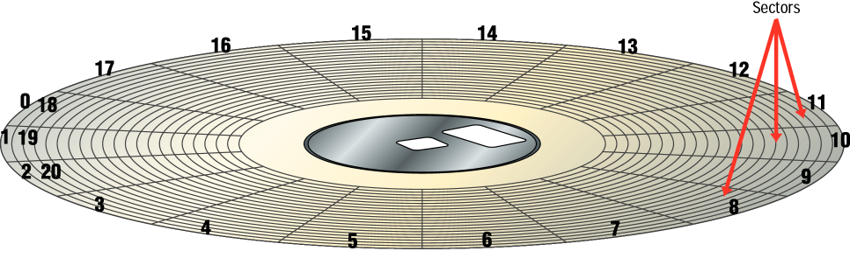
Formatted Disk

Slide 12
Magnetic Storage Devices - Disk Areas
  When a disk is formatted, the OS creates four
  areas on its surface:
Boot sector – stores the master boot record, a small program that runs when you first start (boot) the computer
File allocation table (FAT) – a log that records each file's location and each sector's status
Root folder – enables the user to store data on the disk in a logical way
Data area – the portion of the disk that actually holds data

Slide 13
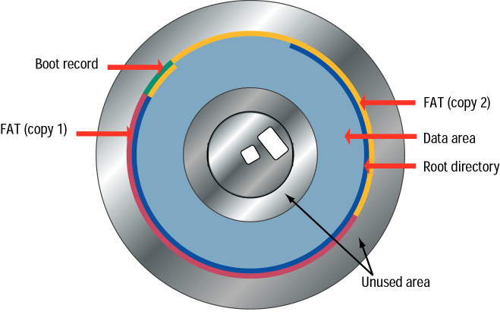

Slide 14
Magnetic Storage Devices - Diskettes
Diskette drives, also known as floppy disk drives, read and write to diskettes (called floppy disks or floppies).
Diskettes are used to transfer files between computers, as a means for distributing software, and as a backup medium.
Diskettes come in two sizes: 5.25-inch and 3.5-inch.

Slide 15
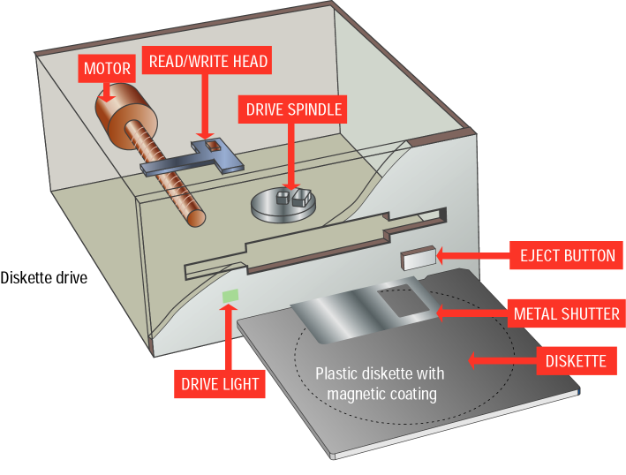
3.5 inch
floppy
and drive

Slide 16
Magnetic Storage Devices - Hard Disks
Hard disks use multiple platters, stacked on a spindle. Each platter has two read/write heads, one for each side.
Hard disks use higher-quality media and a faster rotational speed than diskettes.
Removable hard disks combine high capacity with the convenience of diskettes.

Slide 17
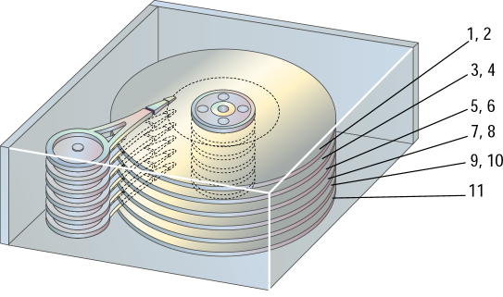
Read/write heads

Slide 18
Magnetic Storage Devices - Disk Capacities
Diskettes are available in different capacities, but the most common store 1.44 MB.
Hard disks store large amounts of data. New PCs feature hard disks with capacities of 10 GB and higher.

Slide 19
Magnetic Storage Devices -
Other Magnetic Storage Devices
High-capacity floppy disks offer capacities up to 250 MB and the portability of standard floppy disks.
Disk cartridges are like small removable hard disks, and can store up to 2 GB.
Magnetic tape systems offer very slow data access, but provide large capacities and low cost.

Slide 20
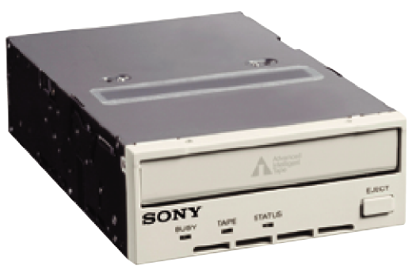
Due to long access times, tape
drives are used mainly for backups.

Slide 21
Optical Storage Devices
How Optical Storage Works
CD-ROM
CD-ROM Speeds and Uses
DVD-ROM
Other Optical Storage Devices

Slide 22
    Optical Storage Devices –
    How Optical Storage Works
An optical disk is a high-capacity storage medium. An optical drive uses reflected light to read data.
To store data, the disk's metal surface is covered with tiny dents (pits) and flat spots (lands), which cause light to be reflected differently.
When an optical drive shines light into a pit, the light cannot be reflected back. This represents a bit value of 0 (off). A land reflects light back to its source, representing a bit value of 1 (on).

Slide 23
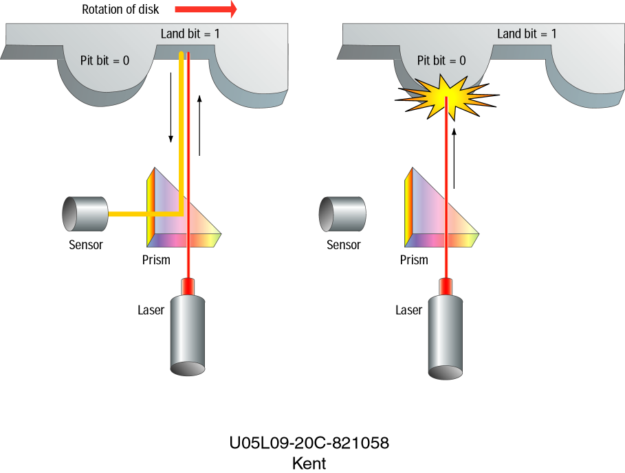
1
0

Slide 24

Optical Storage Devices –
CD-ROM
In PCs, the most commonly used
optical storage technology is called
Compact Disk Read-Only Memory (CD-ROM).
A standard CD-ROM disk can store up to 650 MB of data, or about 70 minutes of audio.
Once data is written to a standard CD-ROM disk, the data cannot be altered or overwritten.

Slide 25
Optical Storage Devices –
CD-ROM Speeds and Uses
Early CD-ROM drives were called single speed, and read data at a rate of 150 KBps. (Hard disks transfer data at rates of 5 – 15 MBps).
CD-ROM drives now can transfer data at speeds of up to 7800 KBps. Data transfer speeds are getting faster.
CD-ROM is typically used to store software programs. CDs can store audio and video data, as well as text and program instructions.

Slide 26
Optical Storage Devices - DVD-ROM
A variation of CD-ROM is called Digital Video Disk Read-Only Memory (DVD-ROM), and is being used in place of CD-ROM in many newer PCs.
Standard DVD disks store up to 9.4 GB of data—enough to store an entire movie. Dual-layer DVD disks can store up to 17 GB.
DVD disks can store so much data because both sides of the disk are used, along with sophisticated data compression technologies.

Slide 27
Optical Storage Devices -
Other Optical Storage Devices
A CD-Recordable (CD-R) drive lets you record your own CDs, but data cannot be overwritten once it is recorded to the disk.
A CD-Rewritable (CD-RW) drive lets you record a CD, then write new data over the already recorded data.
PhotoCD technology is used to store digital photographs.

Slide 28
lesson 9 Review
List four types of magnetic and four types of optical storage devices.
Identify three common uses for floppy disks.
Name the four areas created on a magnetic disk during formatting.
Explain how data is stored on the surface of magnetic and optical disks.
List three variations on optical disk technology.

